Slide 1
National Action Plan for the Conservation and Management of Ecuador’s Sharks (PAT-EC).
Traceability in Shark Fin Exports
Santa Martha, November 25-27, 2014
Blga. Mariuxy García D
Vice-ministry of Aquaculture and Fisheries
mariuxy.garcia@pesca.gob.ec

Slide 2
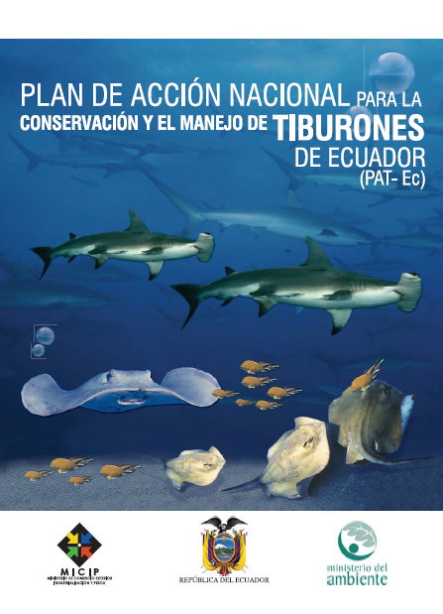
Notes:
Ensure the conservation and sustainable management of sharks, rays and Chimaeras found in Ecuadorian waters, under the auspices of the Code of Conduct for Responsible Fisheries and national, regional and international laws subscribed by Ecuador.

Slide 3
Antecedent
Executive Decrees
Ministerial Agreements
N° 001
N° 486
PAT-EC
N°093
N° 902
N° 116
Notes:
Executive decree #486 was published in the RO #137 of July 30th, 2007, and it establishes the following:
Art.5 states: The practice of shark finning, defined as the capture of sharks for the sole purpose of harvesting their fins and discarding the bodies back into the sea, is hereby prohibited.
Art. 7.- Only the landing of whole sharks resulting from incidental fishing by vessels registered with the Sub-secretariat of Fishing Resources and the port authorities, located throughout the continental coast, will be permitted for their commercialization. The severing of the fins can only be done on land, at the landing ports located throughout the continental coast.
Executive Decree 902
The conservation and management of Sharks as a resource is established as a policy of the Ecuadorian state through the implementation of the PAT-EC. (1-02-2008)
Ministerial Agreement 001, January 7, 2008
Establishes the payment for authorizations for the incidental fishing of sharks, commercialization and exporting rights provided by the SRP, as follows:
*Monitoring certificate of the landing of sharks, for each body with fins attached (with partial cut) $1
*Movilization Guidess per lot:
body $20
Shark fins $20
*to export sharks $100
dry fins by the kilogram $ 1

Slide 4
Challenges
Ensuring that the collection of data, the evaluation and the scientific research are sufficient and adequate
Achieving the sustainable management of fisheries, especially those which target species of diverse biological productivity and of those species target in two or more fisheries
Establishing permanent and complementary management agreements among fisheries
Ensuring the allocation of financial resources for implementation

Slide 5
COMPONENTS OF THE PAT-EC
Information and monitoring system and applied research.
Regulations, management and incentives.
Control and oversight.
Education and awareness.
Notes:
Improving control, oversight and compliance with the law, regarding the current guidelines on shark and ray protection.
Upholding and enforcing the no-finning stance in Ecuadorian fisheries
Improving the management of information, involvement of the parties and the interinstitutional coordination on aspects of control, oversight and compliance with the law
Promoting the adoption of management and conservation measures at the national and regional levels

Slide 6
Distribution of the Fisheries Inspection Posts
ESMERALDAS
SAN LORENZO
ROCAFUERTE
RIO VERDE
ESMERALDAS
MUISNE
TONCHIGUE
13
PICHINCHA: Quito
MANABI
NAPO: Tena
EL MATAL
PEDERNALES
BAHIA DE CARAQUEZ
MANTA
PUERTO LOPEZ
JARAMIJO
SAN MATEO
1
28
1
STA. ELENA
3
LOS RIOS
LA ENTRADA
SAN PEDRO
PALMAR
SANTA ROSA
ANCONCITO
CHANDUY
BABAHOYO
15
13
GUAYAS
.GUAYAQUIL
.PUNA
.PLAYAS
POSORJA
EL ORO
PUERTO BOLIVAR
HUAQUILLAS
6
Notes:
There currently are 80 fishing inspectors stationed maily on those ports with greater landings

Slide 7
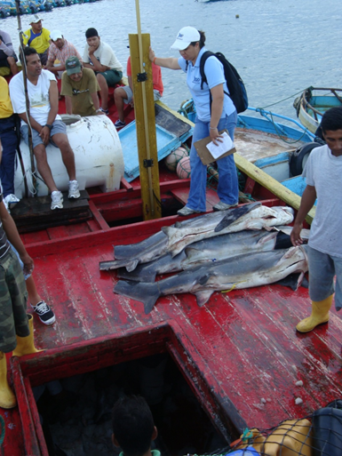
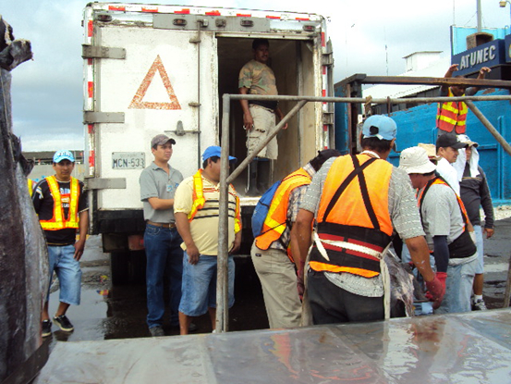
Inspections during landing
Notes:
Landing monitoring is conducted in each port; inspectors have to be proficient in species identification since the monitoring certificate must include both the scientific and common names of the species.

Slide 8
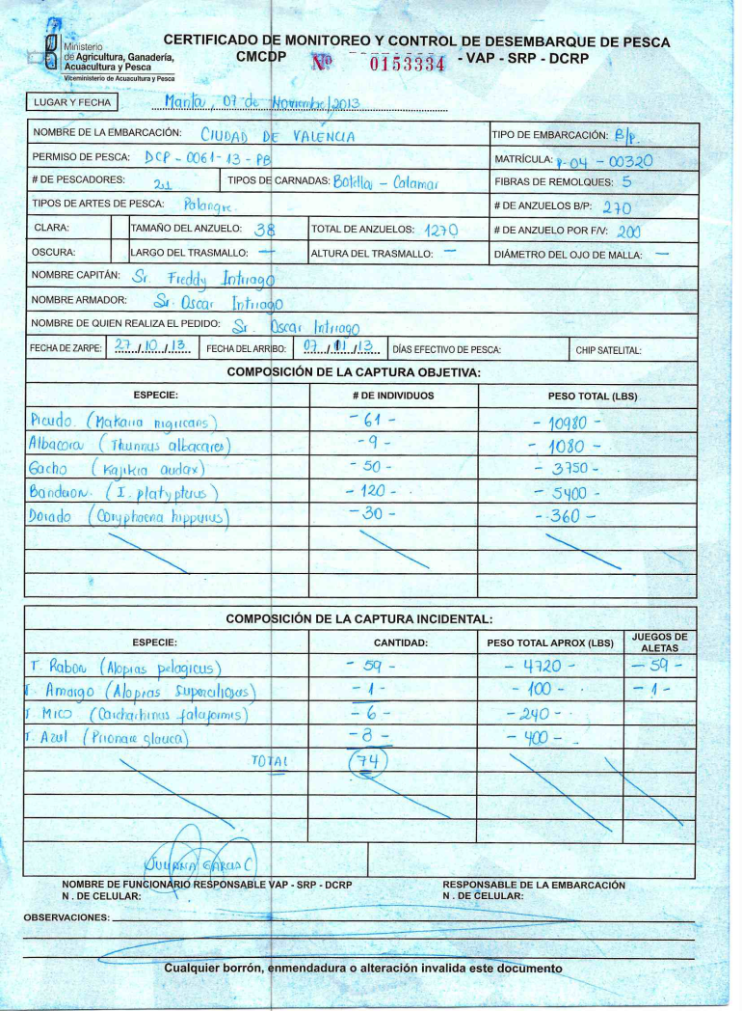
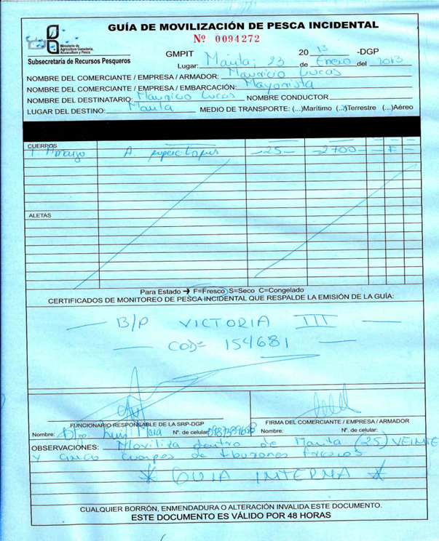
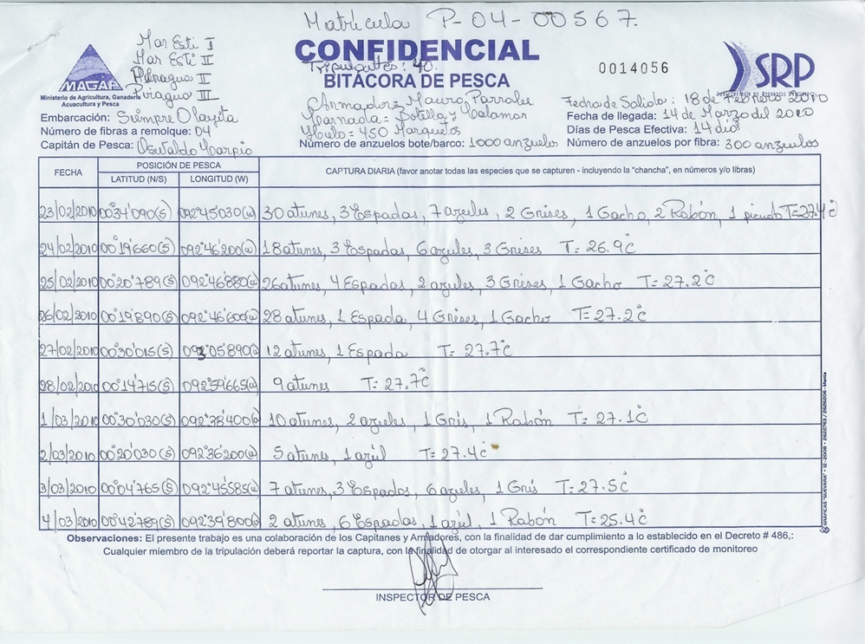
Fishing Logs Monitoring Certificates Movilization Guides
Notes:
Fishing Log: document filed by the captain of vessel
MONITORING CERTIFICATE: Issued to fully licensed fishing retailers
MOVILIZATION GUIDE

Slide 9
Retail Permit
Exporting
Permit
Authorization to conduct fishery at the commercialization phase
Notes:
Small retailer permit = $10.00 Large retailer permit = 50.00 Requirements for both: copy of ID, voting certificate and proof of payment from the bank. Permiso para exportador = Tener acuerdo ministerial que lo autorice a ejercer la actividad pesquera. En la fase de comercializacion el usuario debe solicitar para procesamiento y comercializacion interna y externa REQUISITOS PARA OBTENER ACUERDO MINISTERIAL COMO PERSONA NATURAL O JURIDICA (PLANTA) FASE DE PROCESAMIENTO ➢ Solicitud dirigida al Subsecretario de Recursos Pesqueros con firma de abogado y dirección de notificación. ➢ Fotocopia de cédula de identidad y votación a color y nitida. ➢ Registro único de contribuyente. ➢ Contrato de abastecimiento de materia prima. ➢ Plano de distribución de la planta, a escala con firma responsable. ➢ Estudio técnico económico, con firma de profesional responsable. ➢ Licencia Ambiental o EIA aprobado (Emitida por el Ministerio del ambiente). Para personas jurídicas además de lo anterior presentaran lo siguiente ➢ Escritura de constitución de la compañía. ➢ Nombre del o los representantes legales debidamente inscritos en el registro mercantil.

Slide 10
Exporting Process
Submission: VUE/Normal
Guide
Review
Report
Payment Authorization
Report
Inspection
Submission of Proof of Payment
Export
Authorization
Customs
Notes:
Ventanilla Única Ecuatoriana para el Comercio Exterior (VUE).

Slide 11
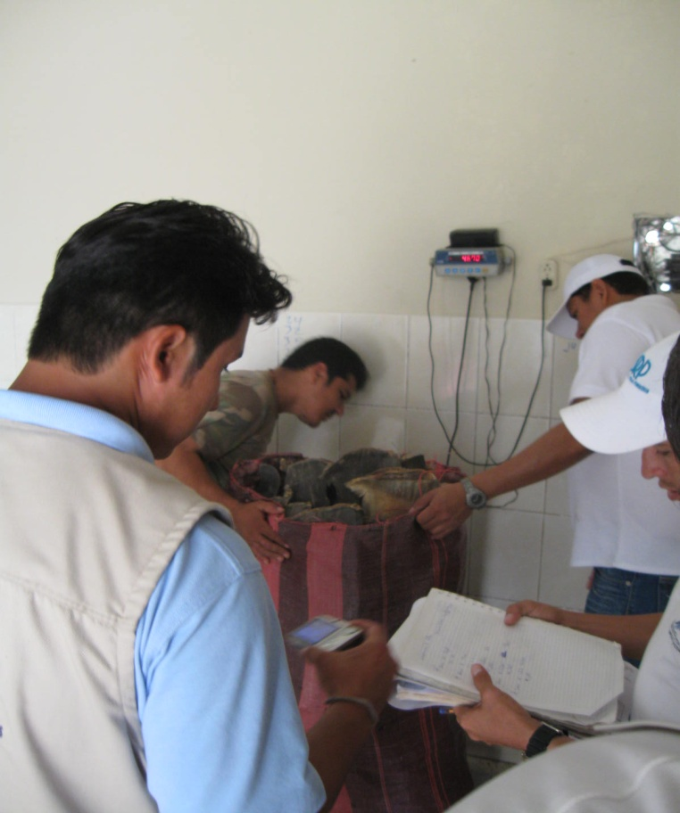
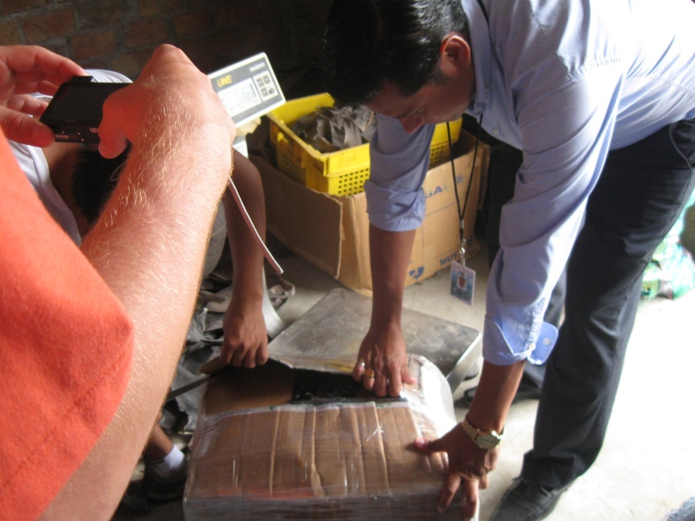
Inspections

Slide 12
Ecuapass

Slide 13
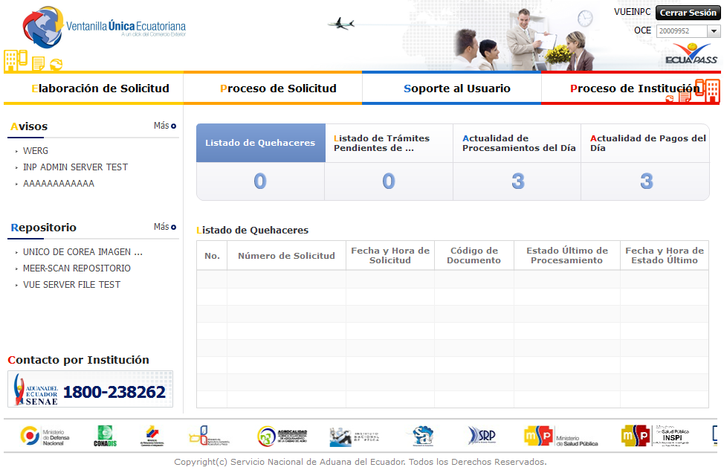
VUE portal main page structure

Slide 14
Notes:
The submission features 11 sections. Each part is thoroughly detailed

Slide 15
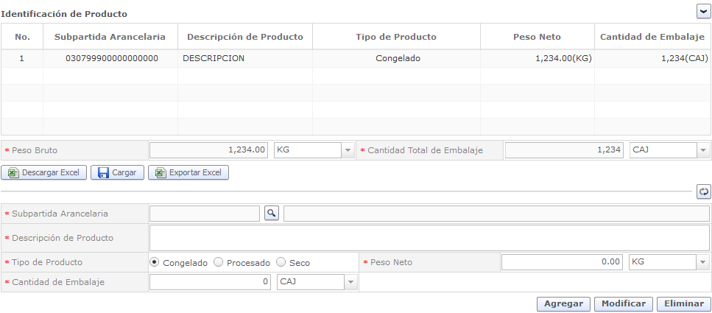

Slide 16
Thank You!

